Slide 1
New Water Intake & Huron Avenue Reconstruction
April
2024
Public Information Centre
Notes:
This project has been awarded to JI Enterprises and is about to begin construction. The purpose of this initial consultation meeting was to inform residents of the project and obtain feedback related to the design of the project and the mitigation of project impacts. This pre-construction meeting is to communicate the design of the project to the public and residents, as well as discuss impacts of the project and mitigation measures. As always we are seeking feedback from the community so we can serve the needs of our residents as effectively as possible.

Slide 2
New Water Intake & Huron Avenue Reconstruction
Why Huron Ave and Why Now?
WHY?
WHY NOW?
Main arterial road connecting Causley St, (HWY 17) to HWY 557 and Northern Blind River
Aging underground Infrastructure
Deteriorated road surface
Traffic safety concerns
Fits strategic plan to improve accessibility
Pedestrian safety concerns
Blind River’s road life cycle strategy
Asset Management Strategy
Coordination of projects
Pure Huron Project
Woodward Avenue
Notes:
You might be asking yourself why Huron Ave and Why are we doing it now. If you’ve driven it previously, you might not be asking that question.

Slide 3
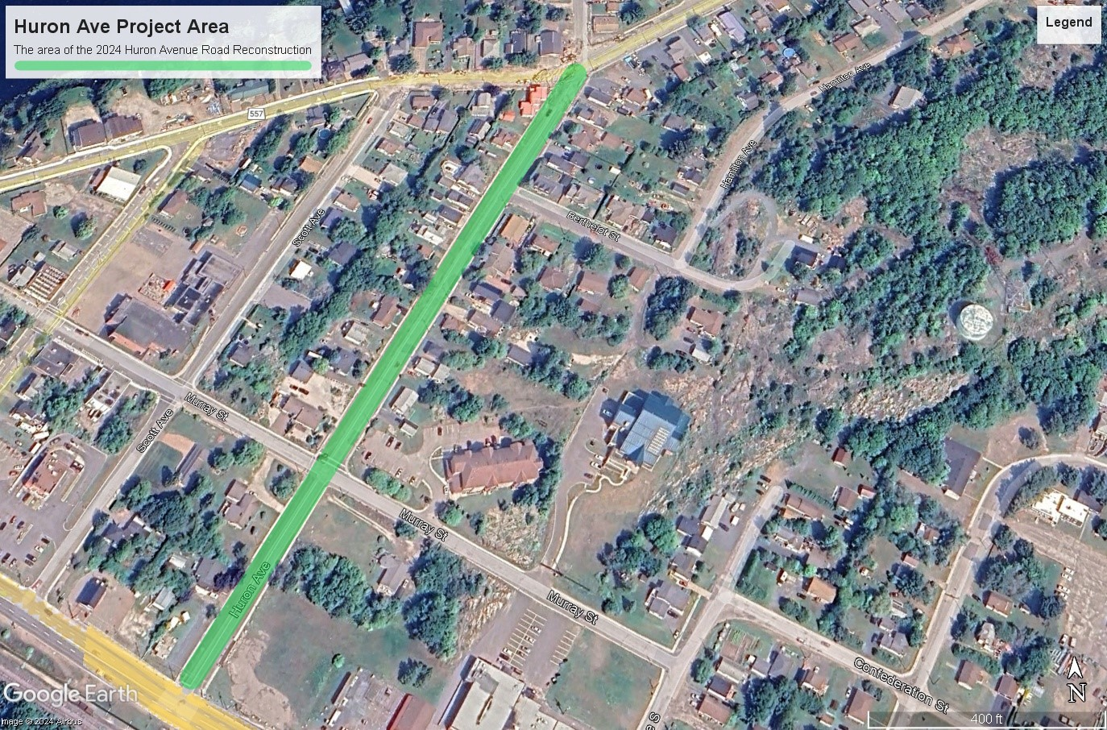
Scope of Project
Notes:
The project area encompasses the entire length of Huron Ave

Slide 4
Scope of Project Phase 1
Notes:
There has been a slight change to the project and it will now be split into two phases of completion
Phase 1 covers the intersection of Woodward to the intersection of Murray St.

Slide 5
Scope of Project Phase 2
Notes:
Phase 2 will take us to the completion of the project beginning in Spring 2024

Slide 6
Timeline of Project 28 Weeks Total Construction
2024
Woodward Ave to Murray St.
Full completion in 2024
2025
Murray St. To Causley St.
Full Completion in 2025
All new underground infrastructure
All new underground infrastructure
New asphalt and sidewalks
New asphalt and sidewalks
Installation of new raw water intake
Notes:
More information related to project phasing and schedule will be made public through the Town of Blind River Website and future Public Consultation Meetings

Slide 7
Project Components Phase 1
Asphalt Reconstruction
Sidewalk Reconstruction
Curb Reconstruction
Water Main Replacement
Sanitary Sewer Replacement
Storm Sewer Replacement
Begin installation of new raw water main as part of the ‘Pure Huron’ new water source project
7

Slide 8
Project Components Phase 2
Asphalt Reconstruction
Sidewalk Reconstruction
Water Main Replacement
Sanitary Sewer Replacement
Storm Sewer Replacement
Completion of installation of new raw water main as part of the ‘Pure Huron’ new water source project
8

Slide 9
Project Components Phase 2
Asphalt Reconstruction
Sidewalk Reconstruction
Water Main Replacement
Sanitary Sewer Replacement
Storm Sewer Replacement
Completion of installation of new raw water main as part of the ‘Pure Huron’ new water source project
9

Slide 10
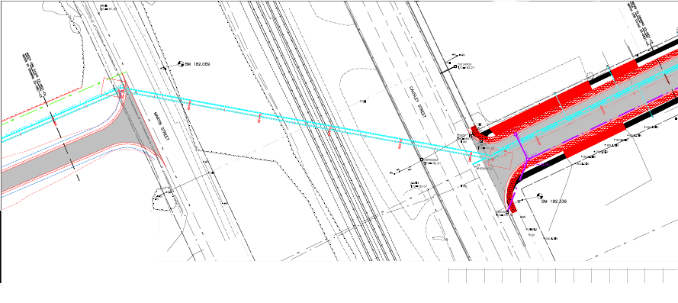
Pure Huron Project
Connecting to Future Work
Installation of the raw water intake for the new water source from Lake Huron is planned to be completed in 2025
The work to connect the raw water intake is scheduled to be completed in 2025
The low lift pumping station is scheduled to begin constructing in 2024 as part of a separate project
Notes:
What you see here is the draft plans for the connection of the raw water main on Huron Ave to the intake in lake Huron. The raw water intake line will tie into a LLPS, the entire project is projected to be completed in 2025.

Slide 11
You Asked, We Listened
Feedback from Initial Design Review
Effective Change
Huron Road is a truck route will narrowing the road restrict access?
With the elimination of the additional space for roadside parking, where will trades people park?
Large vehicle operators are concerned with the intersection of Huron Ave and the highway, is that being addressed in the current design?
What can be done to address safety concerns on Huron Ave?
The road width will remain the standard width, it is only the excess asphalt that is being removed
Roadside parking has been built into the revised design
A redundant sidewalk panel has been eliminated from the design to widen the intersection to Causley and introduce a left turn lane.
Narrowing of the roadway is shown to encourage lower speeds and a signalized pedestrian crossing will be introduced.
Notes:
Initial design review meeting was held on April 16th. We reviewed the proposed new road design with residents of the community to answer their questions and address their concerns. The Q&A from this meeting is posted on the Huron Ave information page on the Town’s website. You can also submit questions and concerns through

Slide 12
Impacts as a Result of the Project
The Town of Blind River will work with local stakeholders to minimize the impacts of the project
The following have been considered
Water Service
Sewer Service
Road closures and Traffic Disruptions
School Bus Pickup
Refuse Collection
Canada Post
Parking Solutions and Driveway Access
Notes:
The Town of Blind River will work with local residents and stakeholders to minimize the impacts of the project as much as possible. Your feedback at the end of the presentation is encouraged.

Slide 13
Water Service
No change to residents
Residents will continue to have potable water service to their homes throughout the project
Temporary disruption to service will occur when switching to and from the temporary supply
These disruptions will be brief and residents will be provided with advanced notice
Notes:
Residents will only experience a temporary loss of water service during the short period required for connecting and disconnecting to the temporary water main.

Slide 14
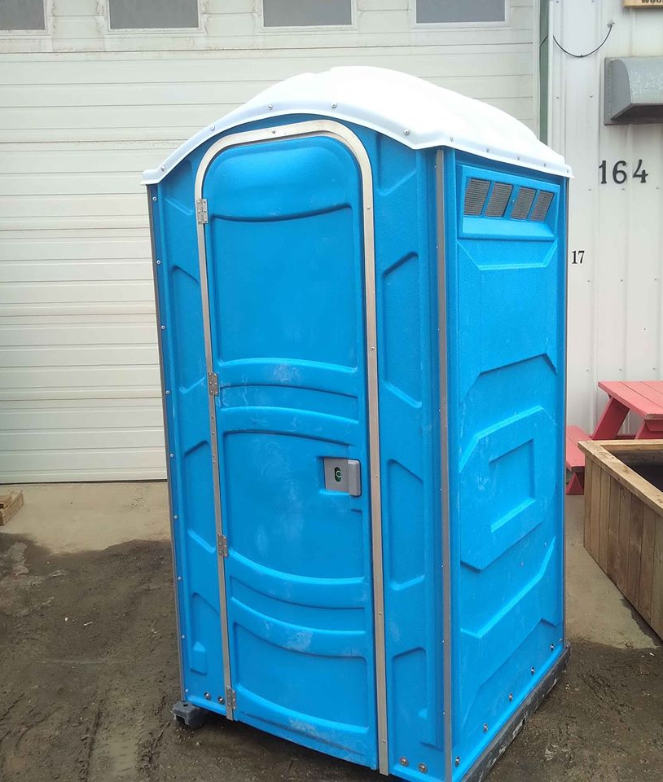
Sewer Service
No change to residents
Residents will continue to have sewer service to their homes
We ask that you please limit sewer usage during working hours while workers are in from
Notes:
This work will reconcile sewer system issues that we have started increase in frequency this past year.
Residence will be connected to temporary sewer service prior be being switch to the new sewer main and will not experience disruption of service.

Slide 15
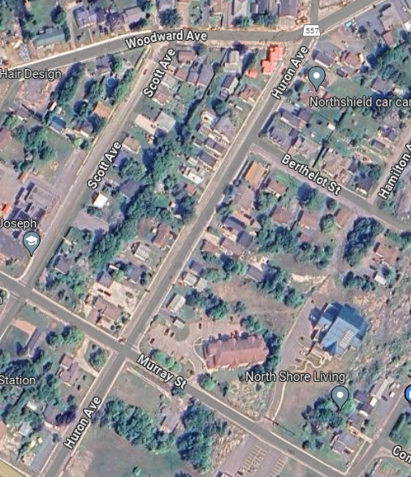
Road Closures
Phased Closures
The project will be completed in smaller phases likely in segments from intersection to intersection
All stakeholders will be consulted to ensure impacts of these closures are minimized
Notes:
These stakeholders include but are not limited to: schools, school bus providers, fire, ambulance and OPP.

Slide 16
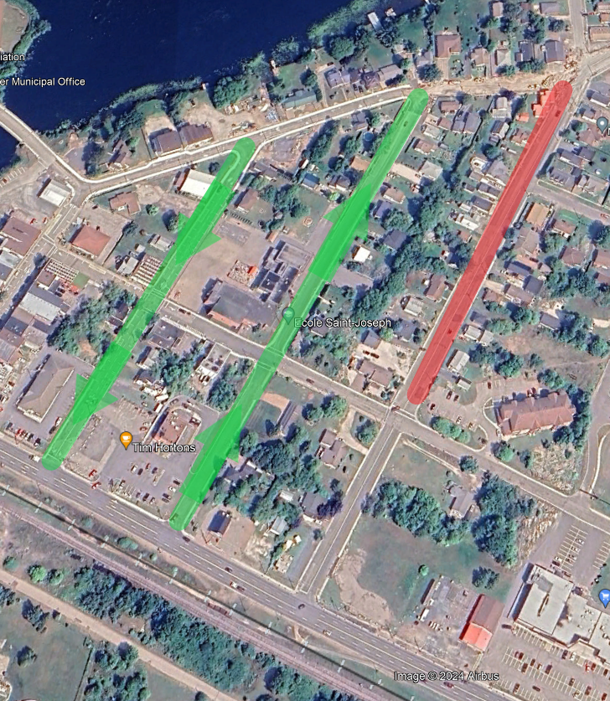
Road Closures
Woodward to Murray St.
Access for traffic will be redirected along Lawton and Scott during full closure

Slide 17
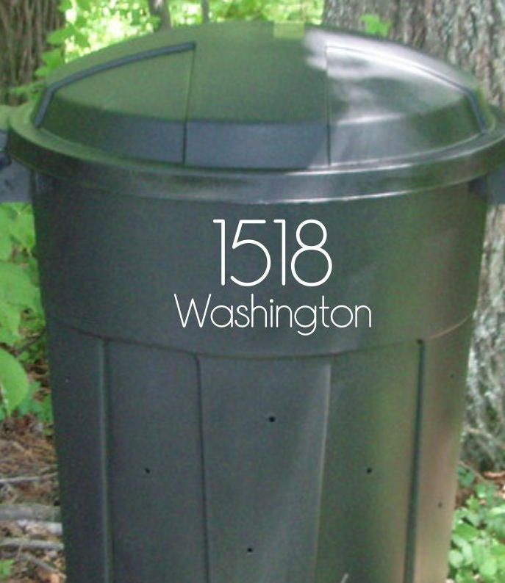
Refuse Collection
No change to residents
30 Huron Ave
Place your waste and recycling at the curb as per normal
Please number your trash and recycling receptacles
Notes:
If your residence is affected in the current phase of work.
Residents are instructed to place their receptacles curbside as they normally would
Contractor will pick up the receptacles and move them to the edge of the roadwork for pick up
Please label your cans and bins for easy return

Slide 18
Canada Post
No interruption to delivery or mail or packages is expected

Slide 19
Driveway Access
Residents will experience a temporary disruption during curb and sidewalk replacement
This will be minimized as much as possible
This access is restricted to ensure longevity of the replaced structures and keep our town (and your property) looking beautiful
Notes:
We understand this will be a significant disruption but we ask residents to be patient for the long-term benefit this will provide.
Don’t forget however, not only will this project enhance the aesthetic appeal of your street, but it will also improve safety and accessibility for all.

Slide 20
Benefits
New Asphalt Road
Narrowed roadway
Reduced maintenance costs
Safer pedestrian and cyclist travel
New Sidewalks
Improved accessibility
Improved pedestrian safety
Pedestrian Crossing
Improved pedestrian safety
Notes:
Asphalt Road
Narrowed roadway reduces speeds while maintaining the same through traffic
Reduced maintenance costs across the board, resulting in more sustainable infrastructure
New Sidewalks
New sidewalks are being installed which will be the full width required for accessibility
In conjunction with rolling(mountable) curbs this creates a barrier free transition from roadway to sidewalk
Improves pedestrian safety
Pedestrian Crossing
A signalized pedestrian crossing will be introduced which further aid in reducing speeds on this road and improving safety for pedestrians

Slide 21
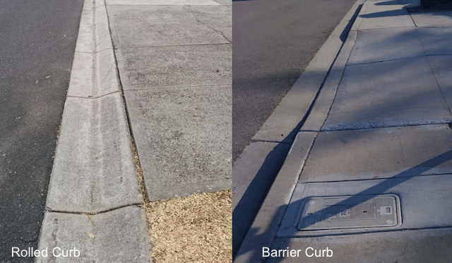
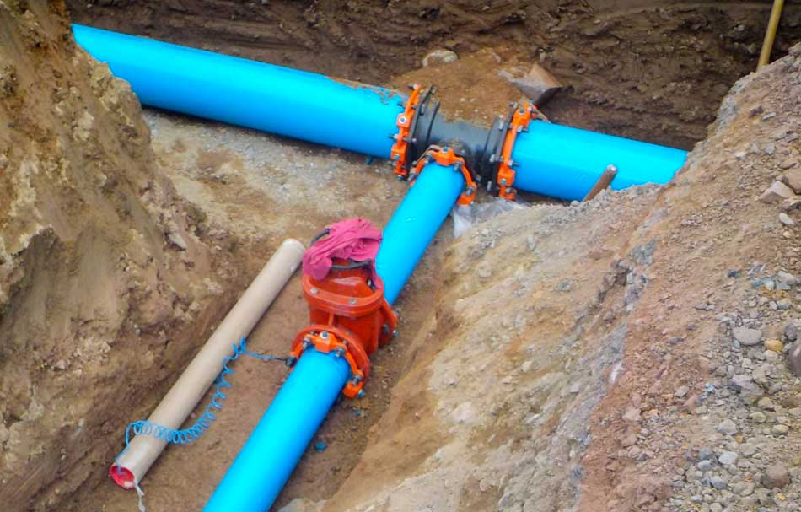
Benefits
New Curbs
Improved accessibility
Improved drainage
New Underground Services
Reduced risk of service interruption or failure
Raw Water Intake Installation
Reduce total cost of Pure Huron Project
Reliable water supply for residents
Notes:
New Curbs
In conjunction with rolling(mountable) curbs this creates a barrier free transition from roadway to sidewalk
New Underground Services
These will address current sewer failure issues
Correct issues with services running across private property
Loop the waster system from Murray to Causley to improve flow
Provide reliable services to residents for the next 50 years
Raw Water Intake Installation
Replacing the intake during this work reduces the overall cost of the project
Switching to the lake will address the capacity issues we are experiencing with our aging well field.

Slide 22
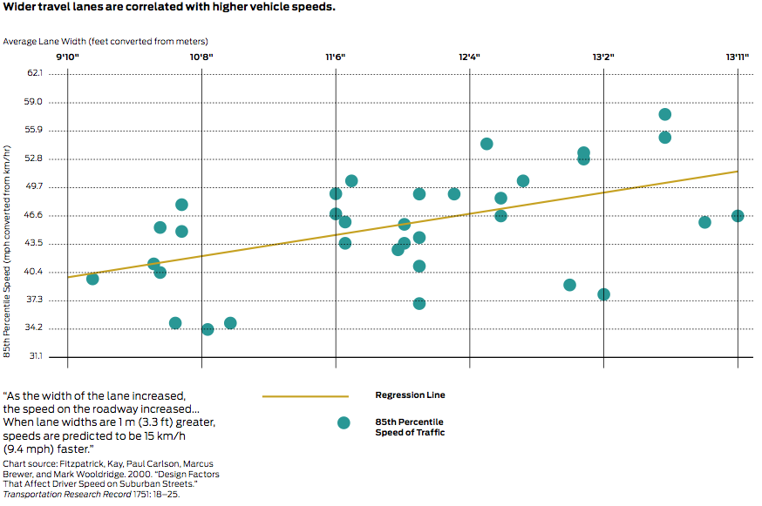
Benefits
Narrower Traffic Lanes = Reduced Speeding
“Narrower Lanes will decrease traffic flow and increase congestions”
Notes:
Wider lanes were once thought to be safer for motorists but studies performed across the globe produce unanimous results with regard to traffic lane width: narrower lanes result in lower speeds and less accidents.
A common misconception is that narrower lanes increase congestion and slow traffic flow but the measured saturation flow rates are similar for lane widths between 10 feet and 12 feet...Therefore, as long as all other geometric and traffic signalization conditions remain constant, there is no measurable decrease in urban street capacity when through lane widths are narrowed up to 10 ft. Appendix A-P, p. A152, Florida Department of Transportation (2007).

Slide 23
Benefits
Reduced Speeds = Safer Roadways
Notes:
At lower speeds the risk of pedestrian death sharply declines further supporting the statement that narrower lanes are safer. When reconstructing a roadway which is used a main pedestrian route for school-age children the safety of the road was one of our main considerations.
Source: Cities Safer by Design (2015)

Slide 24
Continued Communication
Notes:
This meeting isn’t the end of the communication between the Town and residents.
The Q&A and materials from this meeting will be posted to the Huron Ave Project page on the town’s website and accessible to public
Updates will be posted on social media
Consultation will be ongoing with schools, school bus operators and emergency services
The best way to stay up to date is to get registered with Voyent Alert
This app enable real-time notification of urgent information happening in your area via phone, email, text, or through the app – You choose the method you prefer
It also allows you stay up to date with other events taking place in the town – but you choose which categories you are interested in and want to receive information about.

Slide 25
THANK YOU!
For your time
Questions?
Notes:
Closing Remarks
The replacement of the street is an investment in the future of our community. Upgraded infrastructure can attract new businesses and residents, revitalizing our town and helping to create new opportunities for economic growth. Additionally, the new underground services will reduce the likelihood of service disruptions, meaning you won't have to worry about water, sewer or storm water problems in the future. So, while the temporary disruptions may be inconvenient, it is important to keep in mind that the long-term benefits of the upgraded infrastructure will be well worth it in the end.

